Slide 1

Smart Career Guidance: Empowering Students to Choose Their Future
A revolutionary mobile platform that combines AI-powered insights, psychometric testing, and real-time market data to help students navigate their career journey with confidence and clarity.

Slide 2


The Career Confusion Crisis for Students Today
Rapidly Evolving Markets
New careers emerge constantly while traditional roles transform, creating a complex landscape of overwhelming choices for young people entering the workforce.
Outdated Counseling Methods
Traditional career guidance relies on manual processes and subjective opinions, lacking crucial real-time labor market insights and data-driven recommendations.
Widespread Uncertainty
Over 70% of students feel uncertain about their career path after key education milestones like 10th grade, 12th grade, and college graduation.
Costly Misalignment
Without proper guidance, students often end up in mismatched careers, wasting potential, time, and resources while experiencing dissatisfaction.

Slide 3
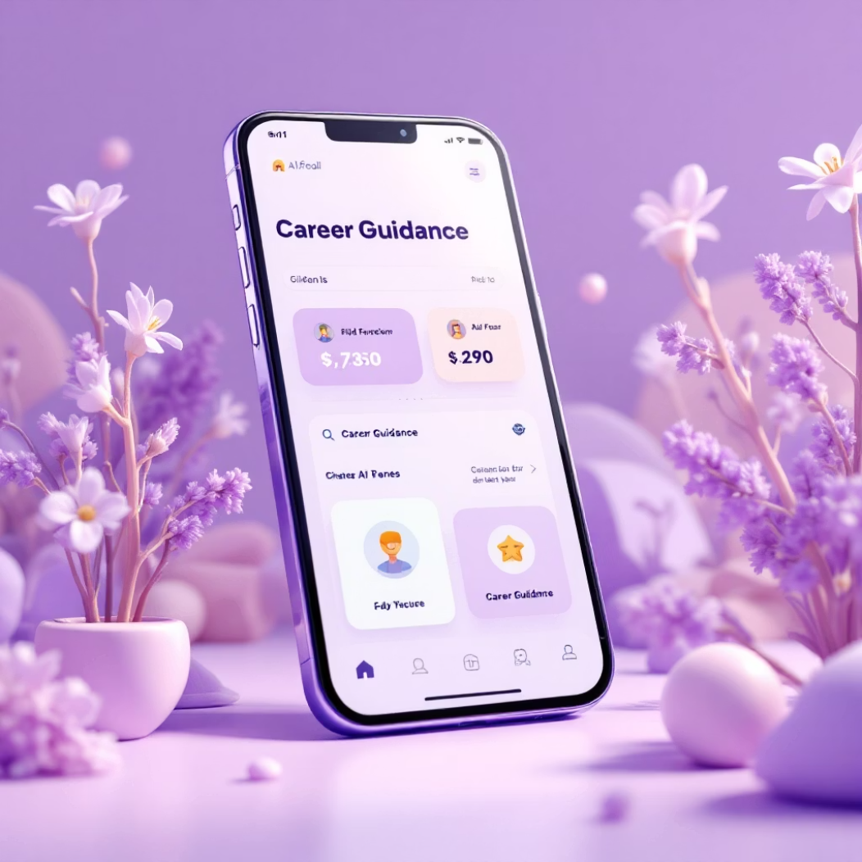
Introducing Empowering Future Pathways: The Smart Career Guidance App
AI-Powered Personalization
Our sophisticated mobile platform delivers personalized career recommendations by analyzing your unique aptitude, personality traits, interests, and aligning them with current market trends and future opportunities.
Comprehensive Career Intelligence
We combine scientifically-validated psychometric assessments, real-time job market analytics, and interactive counseling sessions to provide holistic career guidance that evolves with you.
Scalable Cloud Architecture
Adaptive Android UI
Diverse Career Coverage
Complete Resources
Built on AWS and Firebase for reliable, fast performance anywhere
Jetpack Compose powers an intuitive, responsive user experience
IT, healthcare, arts, business, and emerging offbeat careers
Entrance exams, top institutes, resume building, and goal-setting

Slide 4
Proven Impact & Benefits for Students
01
02
03
Data-Driven Career Roadmaps
Interactive Engagement
Smarter Decision Making
Dramatically reduces career uncertainty by delivering personalized, research-backed pathways tailored to each student's unique profile and aspirations.
Students stay motivated through gamified assessments, real-time feedback, and progress tracking that makes career exploration exciting and rewarding.
Empowers informed choices that lead to higher career satisfaction, better job fit, and stronger alignment between personal strengths and professional goals.
04
05
Research-Backed Results
24/7 Mobile Access
Validated through academic studies and real-world testing with measurably positive outcomes in student confidence and career preparedness.
Continuous guidance available anytime, anywhere on mobile devices, ensuring support exactly when students need it most during their decision-making journey.

Slide 5



Join the Future of Career Guidance Today
Empower Students
Equip the next generation with intelligent tools to navigate complex career landscapes with confidence, clarity, and data-backed insights.
Scale Impact
Partner with schools, parents, and counselors to deliver personalized career support at scale, reaching every student who needs guidance.
Leverage Innovation
Harness cutting-edge AI and cloud technology to build a skilled, adaptive workforce ready for tomorrow's challenges and opportunities.
Ready to Transform Student Futures?
Download the app today or integrate our platform into your institution to revolutionize how students discover and pursue their ideal careers.

